Slide 1
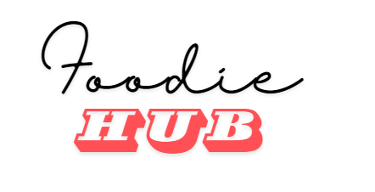
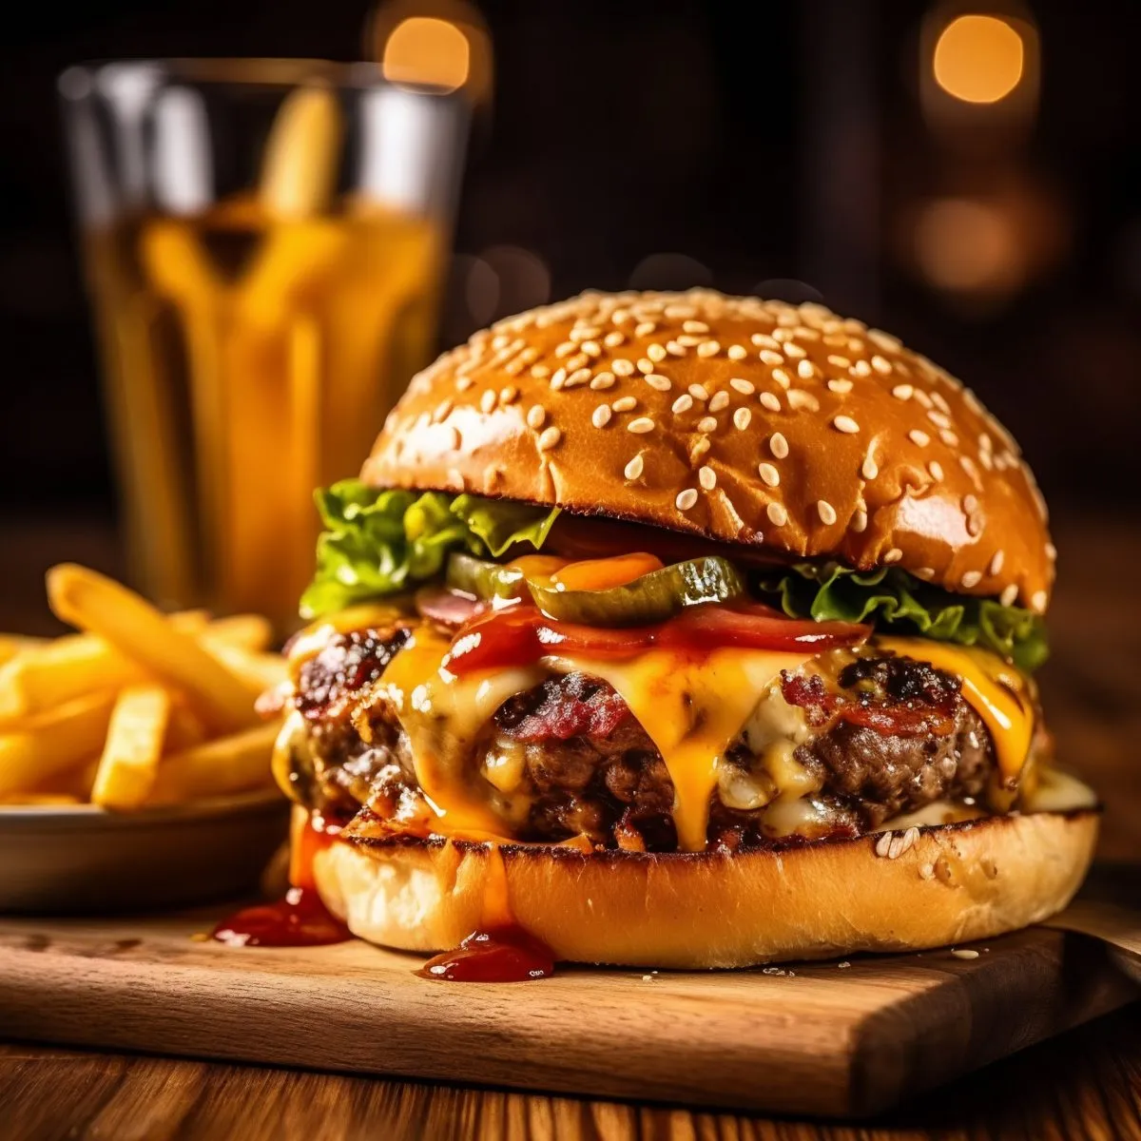
Your Ultimate Food Delivery Service
Made By : Mahnoor Babar
Foodie Hub connects you with a massive collection of local restaurants and eateries, delivering delicious meals right to your doorstep. From international cuisines to quick and easy meal options, Foodie Hub satisfies your cravings with just a few taps.

Slide 2

Introducing the Foodie Hub
Welcome to Foodie Hub, a top-tier food delivery service committed to delivering a wide variety of delectable meals from local eateries right to your doorstep. Built on a love for excellent cuisine and outstanding service, Foodie Hub strives to transform the way you savor your favorite foods.

Slide 3

Background
Foodie Hub was founded in 2024 with a vision to transform the food delivery landscape. Recognizing the growing demand for convenient and diverse dining options, our founders aimed to create a platform that connects people with their favorite local restaurants, offering a seamless and enjoyable food delivery experience.

Slide 4
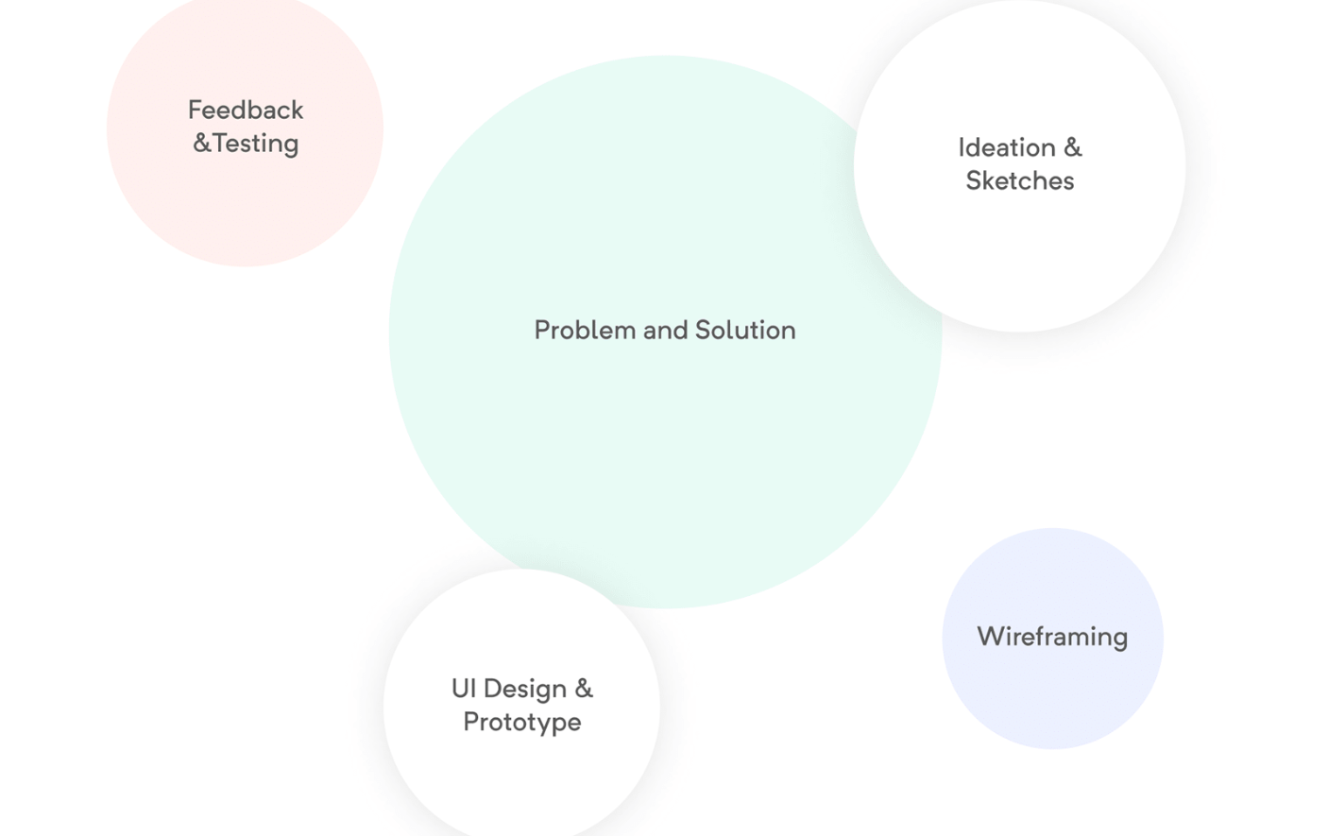
Design Process
To understand the needs and preferences of our target audience, we conducted extensive user research. This included surveys, interviews, and focus groups with potential users. Key insights gathered from the research

Slide 5
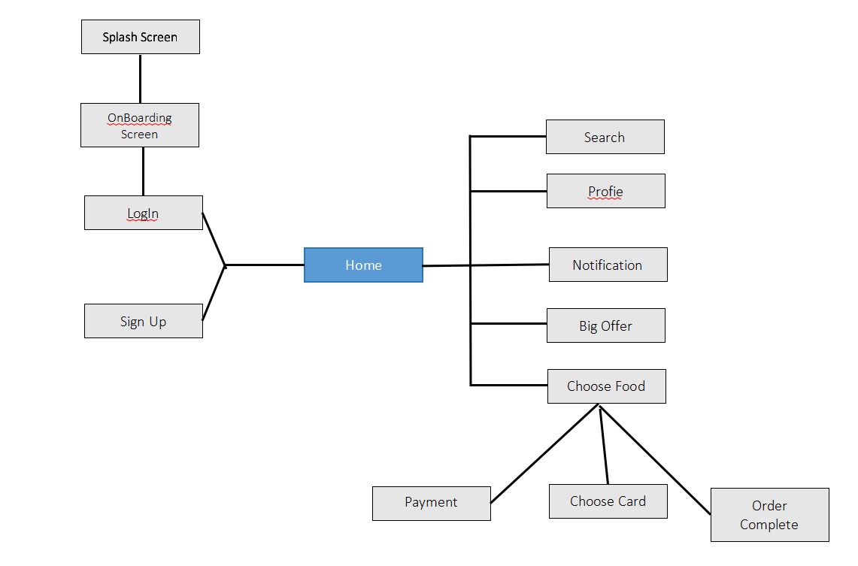
User Flow

Slide 6
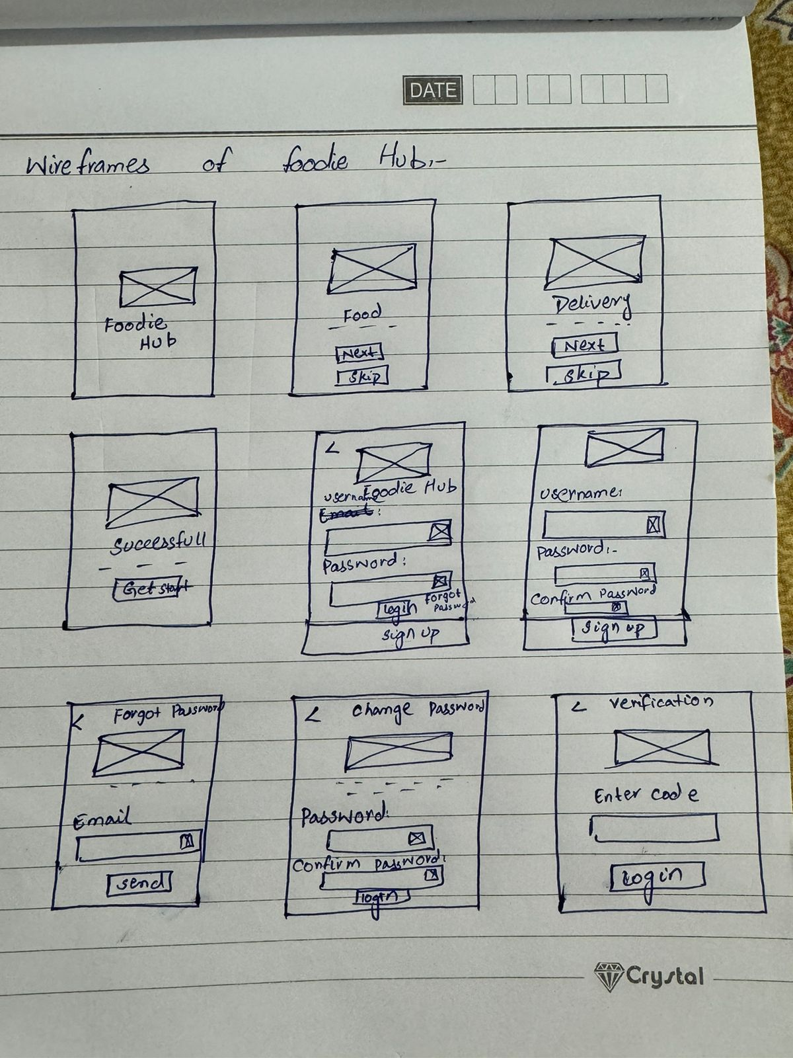
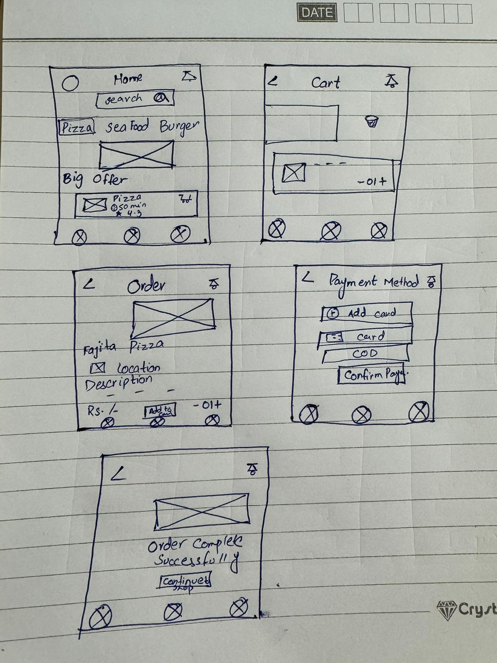
Low Fidelity WireFrames

Slide 7
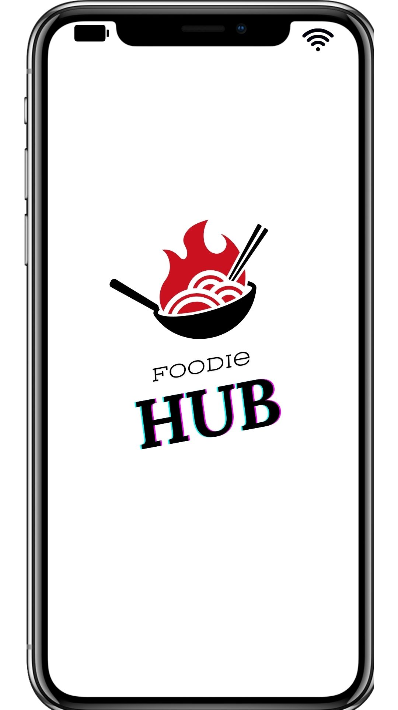
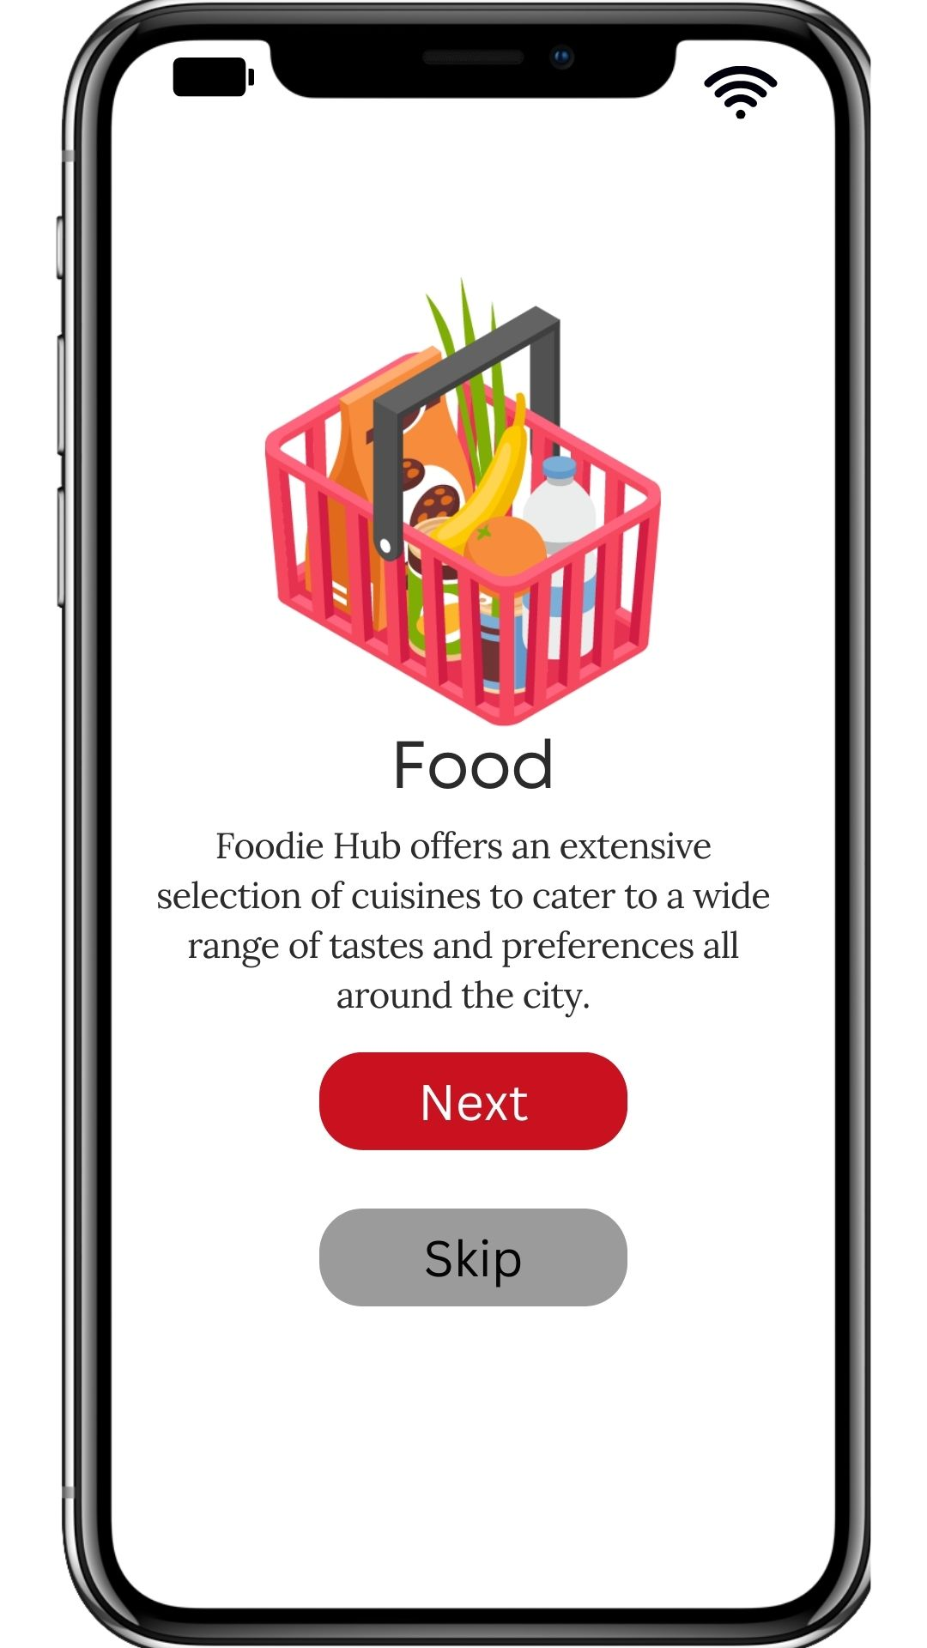
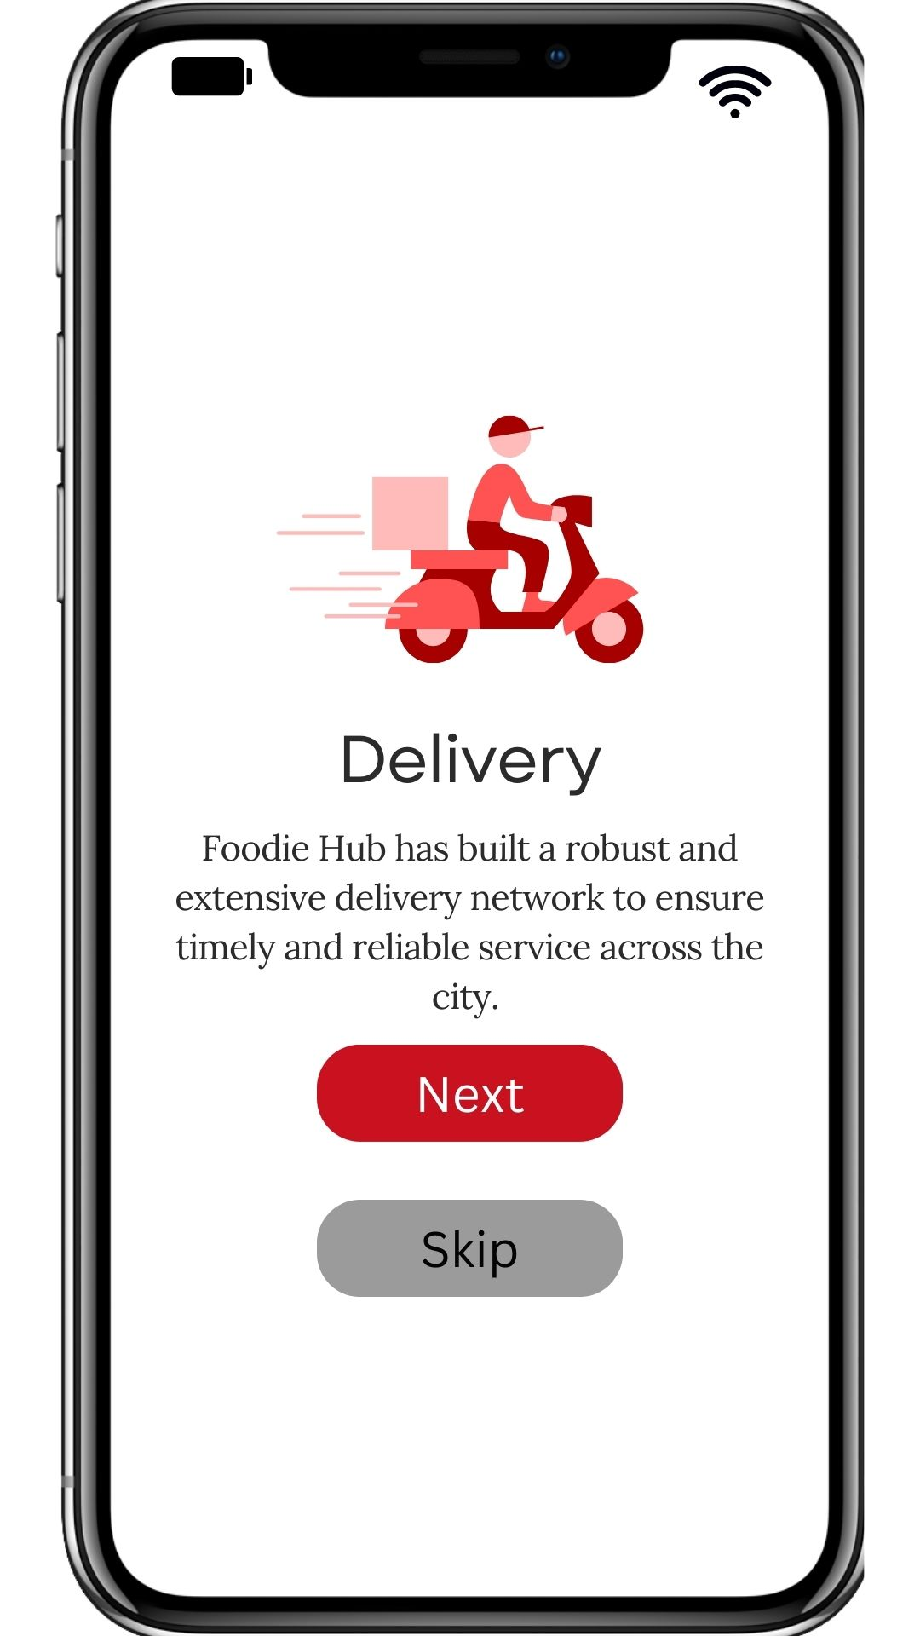
Final Design

Slide 8
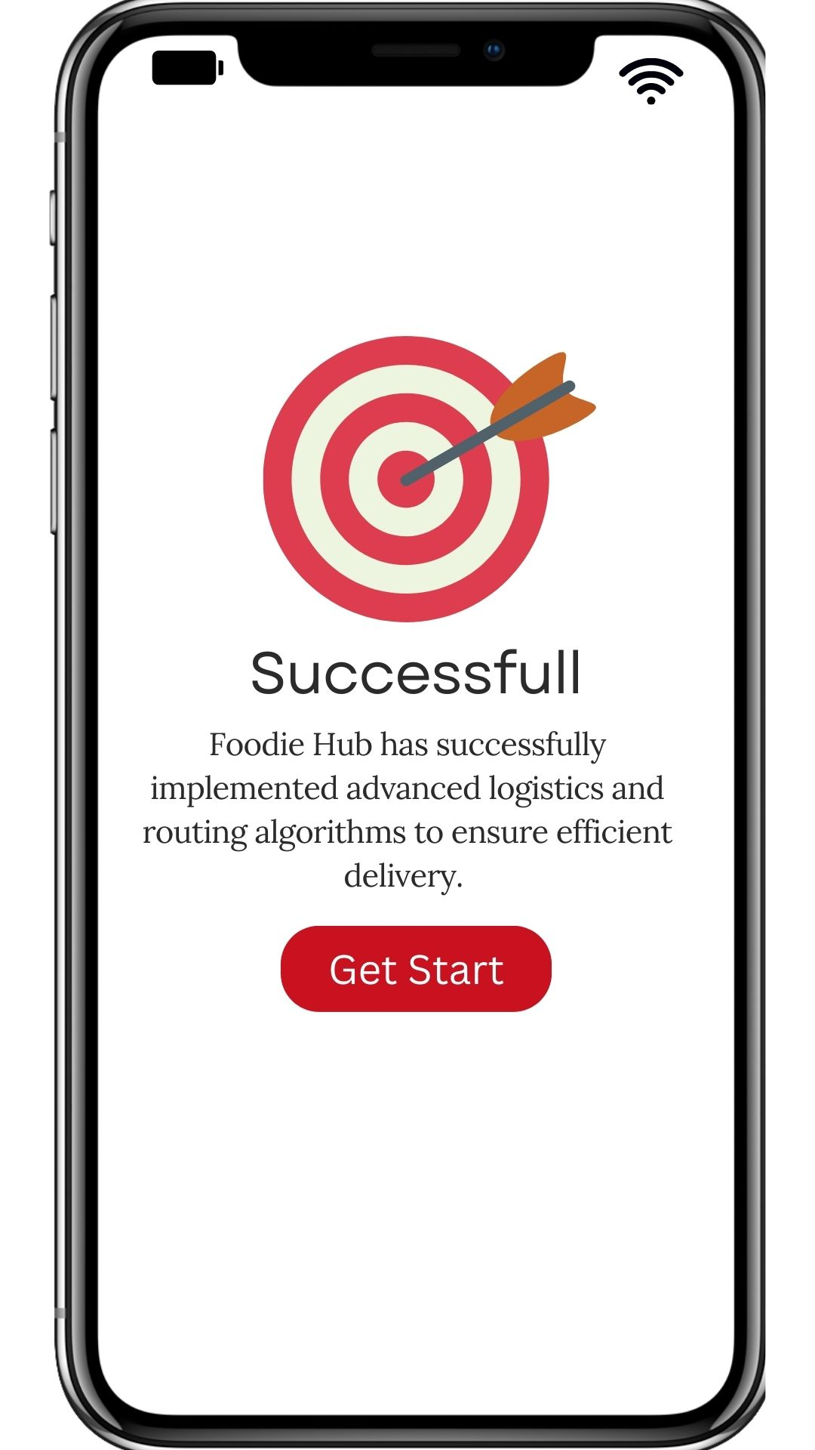
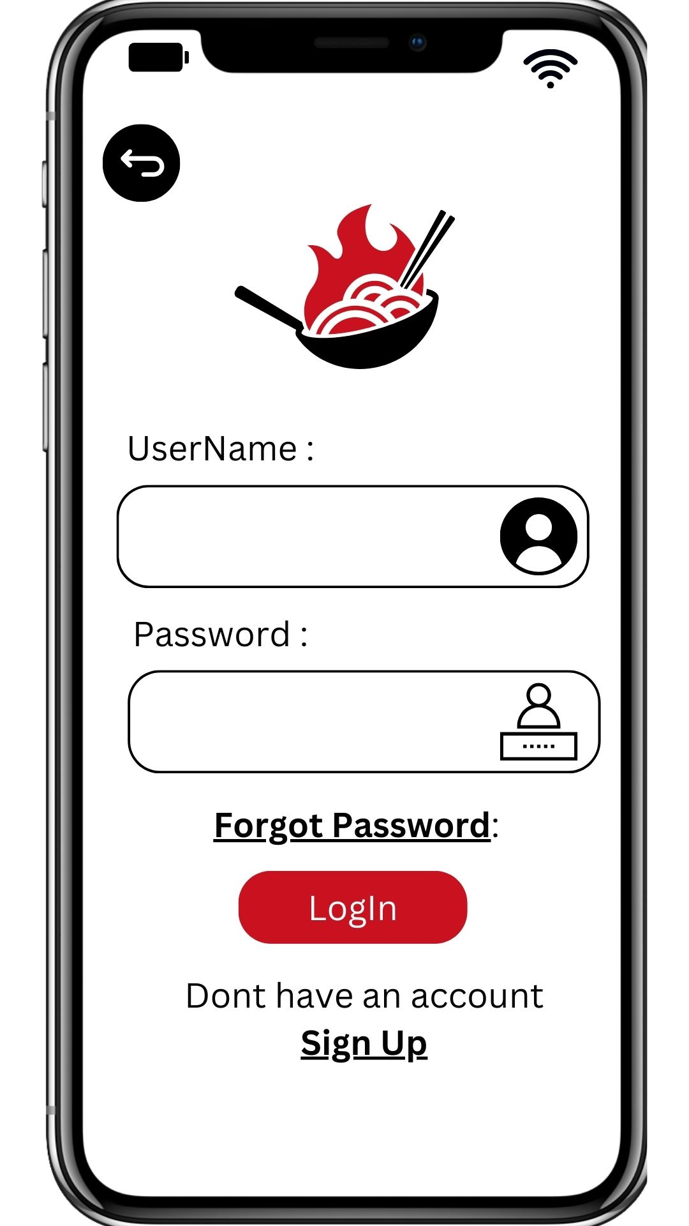
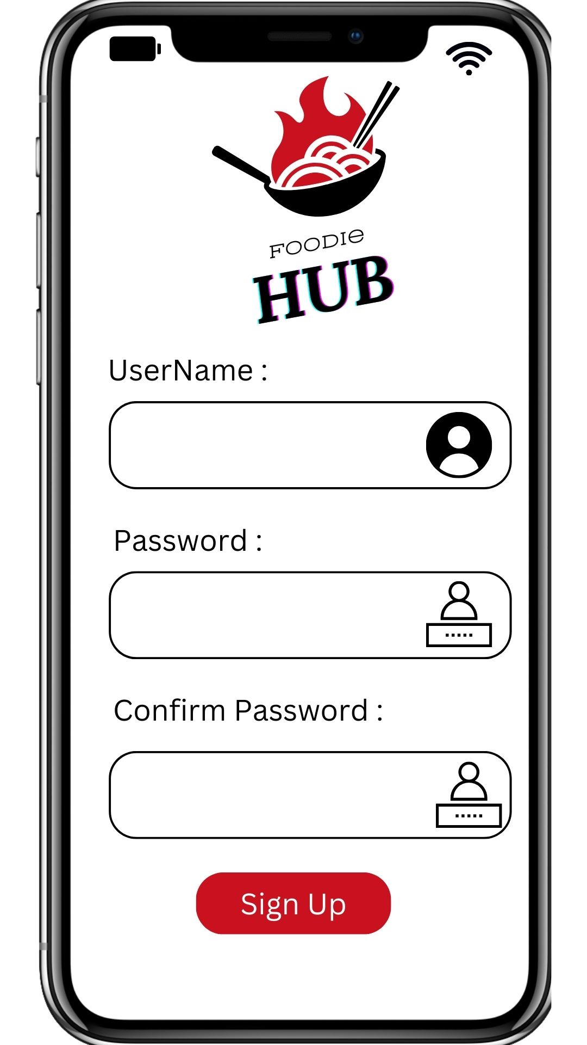
Final Design

Slide 9
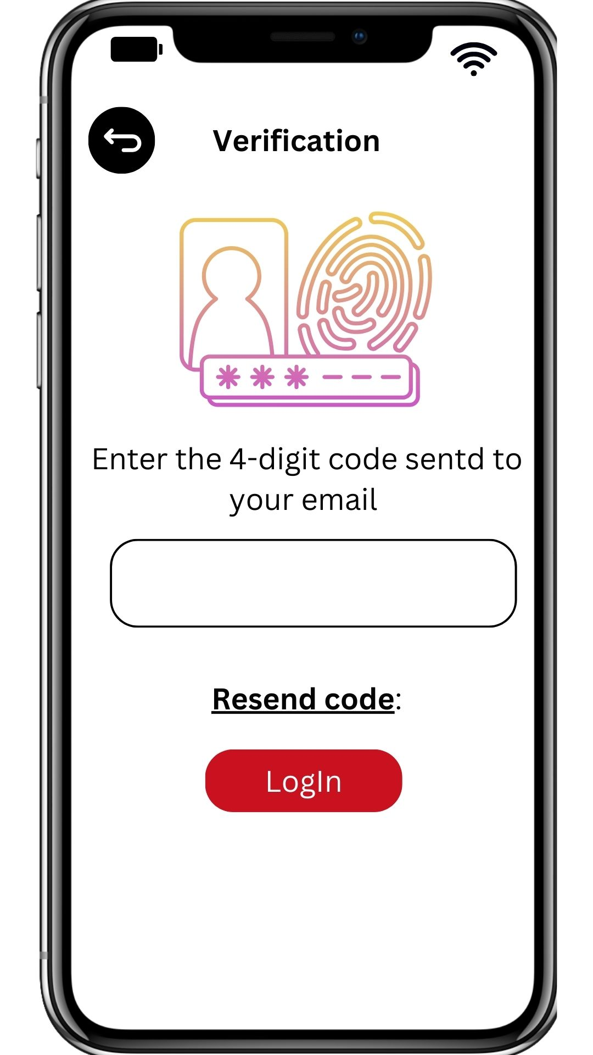
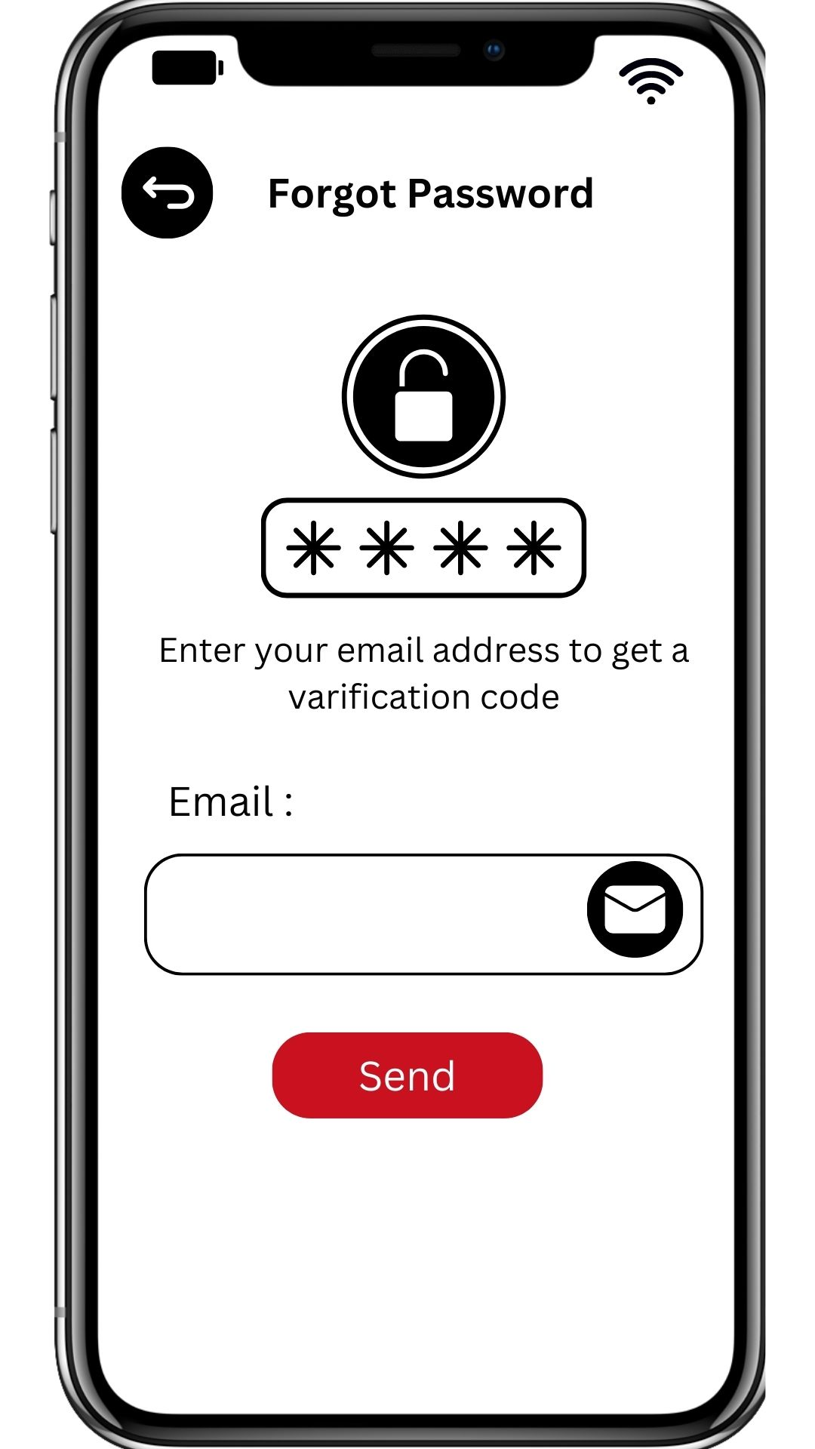
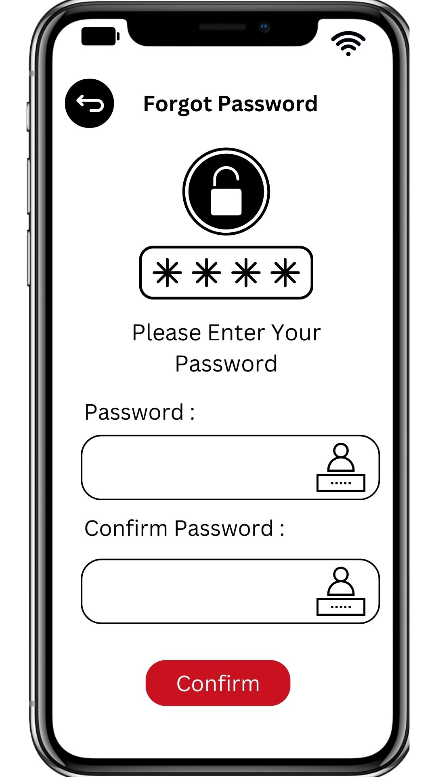
Final Design

Slide 10
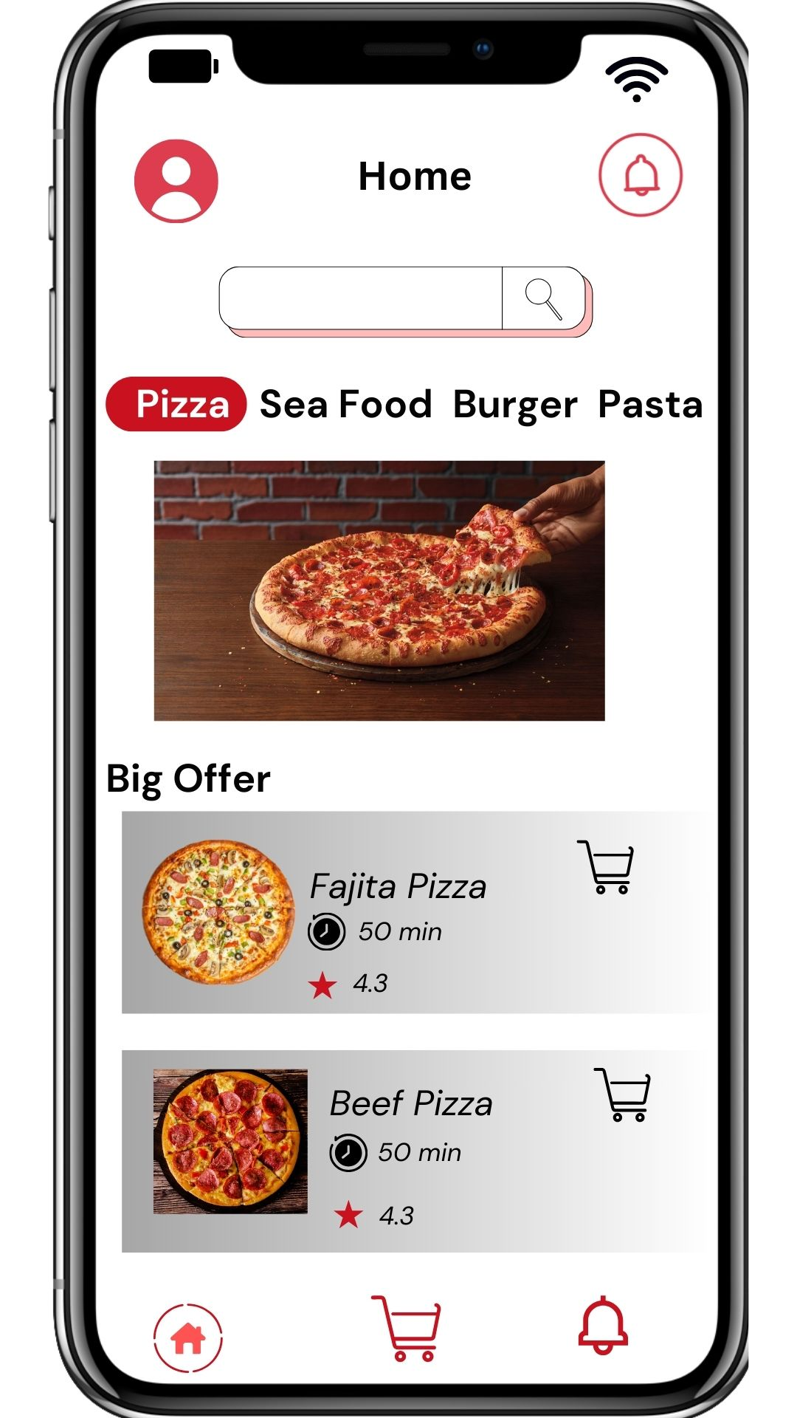
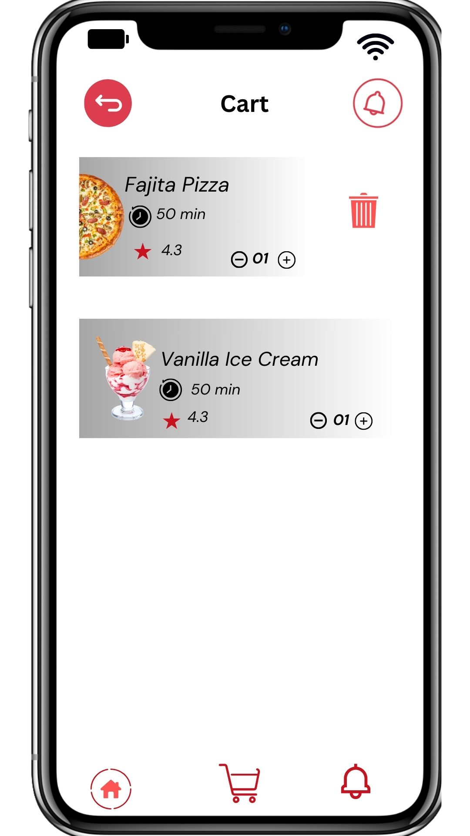
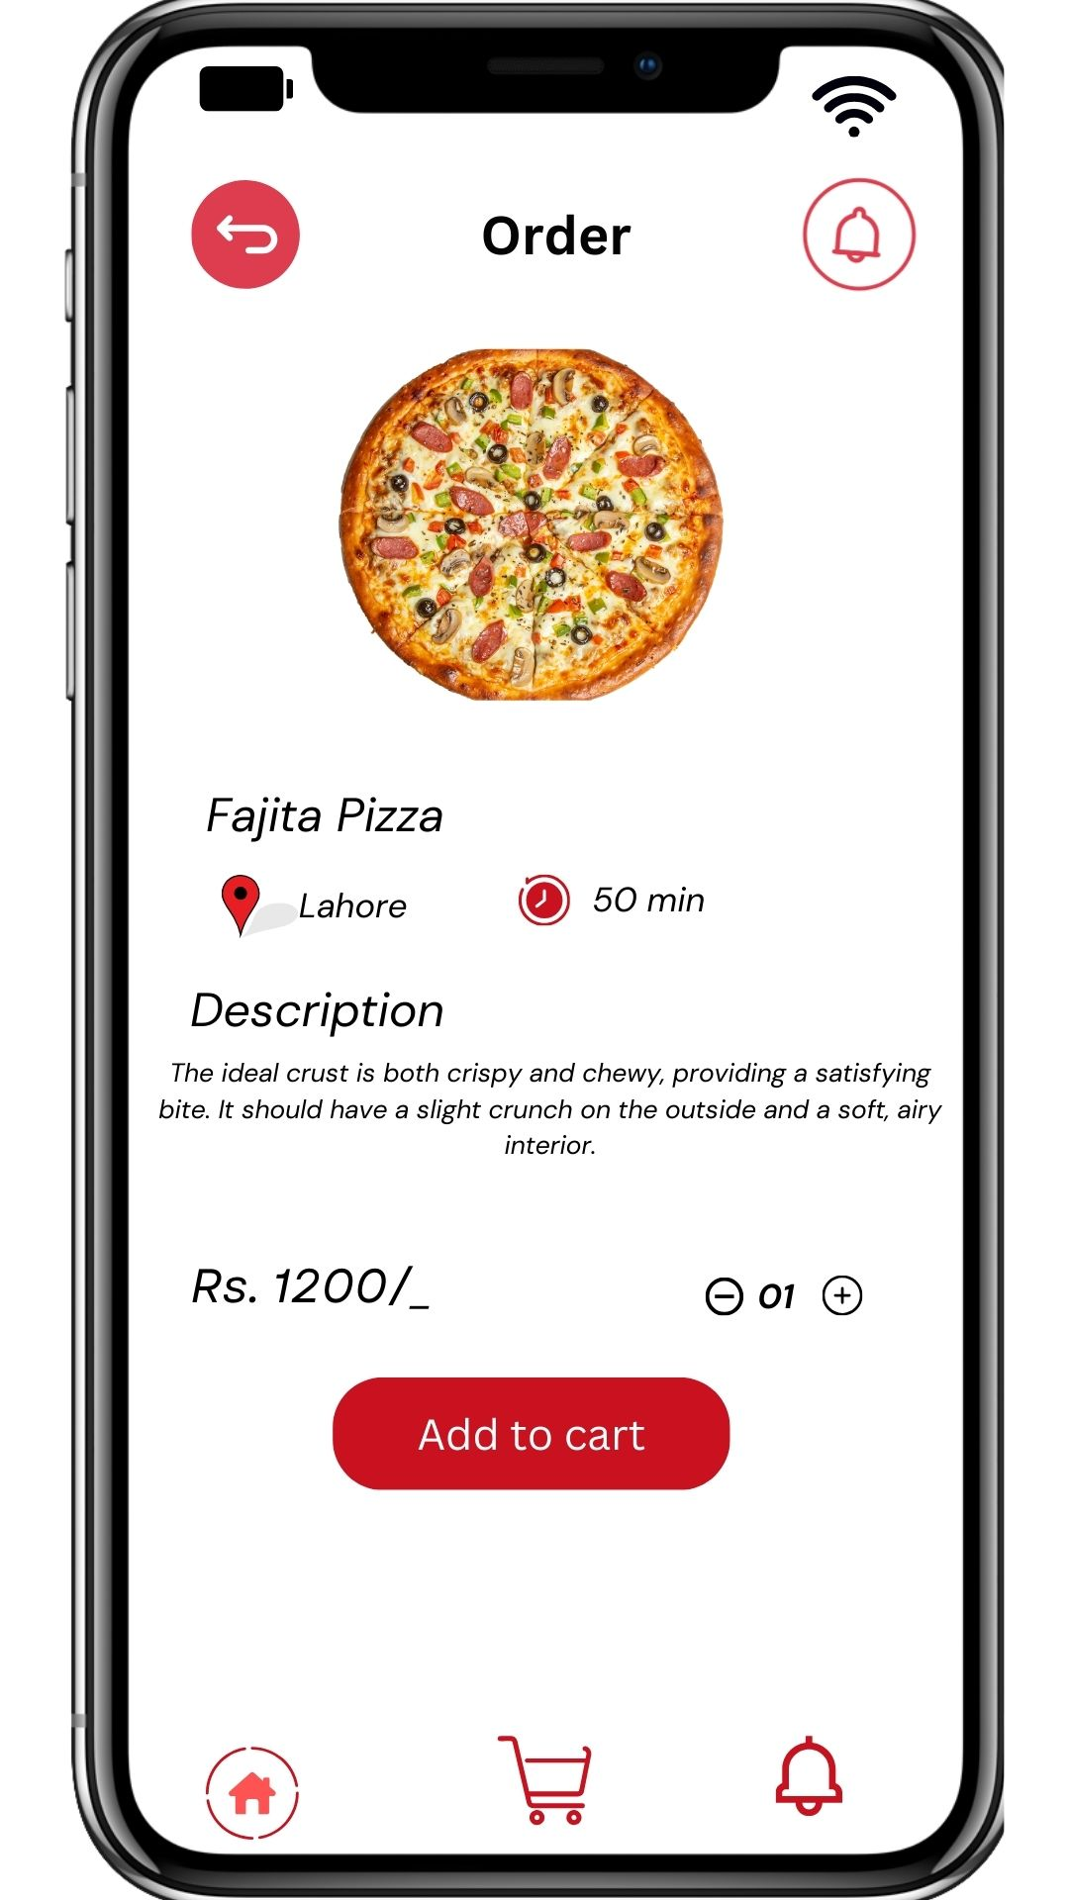
Final Design

Slide 11
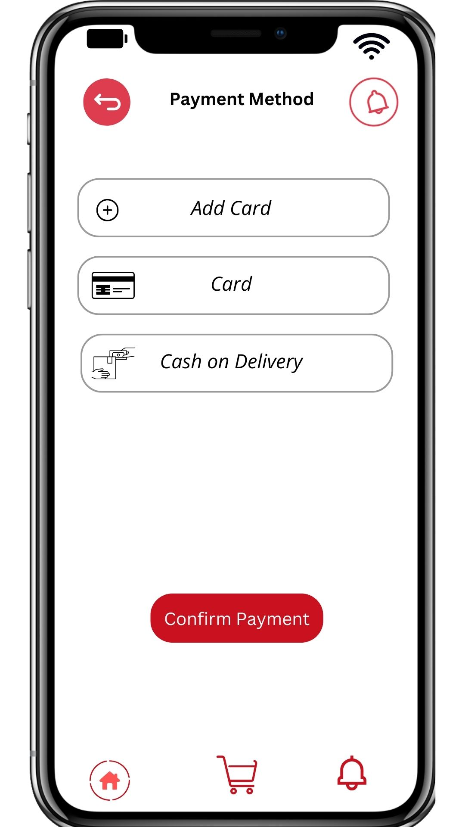
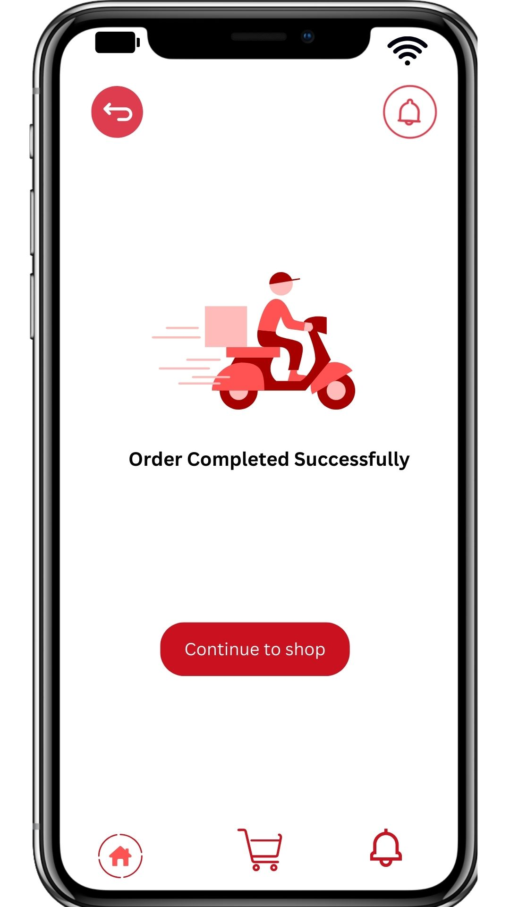
Final Design

